Slide 1

World Wide Energy Consumption Analysis
Presented by :
Venkata Srikar Potharaju
Batch No : 504

Slide 2
About me
My Name is Venkata Srikar Potharaju
B. Tech, EEE graduate from Vellore Institute of Technology Vellore.
I worked as an Associate Software Developer and want to change to Data Domain to analyze and draw insights from Data that help in decision making.
LinkedIn : https://www.linkedin.com/in/venkata-srikar-potharaju-1746b2218
GitHub: https://github.com/vksrikarp

Slide 3
Agenda
Business Problem
Problem Statement
Introduction
ER Diagram and Schema Explanation
SQL Queries Results
Business Key Insights
Conclusion
Recommendations
Q & A

Slide 4
Business Problem
Organizations, governments, and international energy agencies need to understand how energy consumption, energy production, economic growth, population growth, and carbon emissions are interconnected across countries. Without a data-driven understanding of these relationships, it becomes difficult to formulate sustainable energy policies, forecast future energy demand, reduce carbon emissions, and balance economic growth with environmental responsibility across countries.

Slide 5
Problem Statement
Analyze worldwide energy data to evaluate the relationship between energy consumption, energy production, types of emissions, GDP, and population growth across countries and years. The objective is to identify major contributors to global emissions, measure energy efficiency through per-capita and GDP-based metrics, analyze long-term trends, and generate insights that can support sustainable energy planning and policy-making.

Slide 6
Introduction
Energy plays a critical role in economic development and societal progress. As countries expand industrial activities and populations grow, the demand for energy increases significantly. However, increased energy consumption often leads to higher carbon emissions, creating environmental challenges.
This project analyzes global energy consumption data collected across multiple countries and years. Using SQL-based analytical techniques, the study examines energy production, consumption, emissions, GDP, and population trends.
The analysis aims to uncover patterns in energy usage, identify emission-intensive energy sources, evaluate the relationship between economic growth and energy demand, and compare countries based on energy efficiency and sustainability indicators.

Slide 7
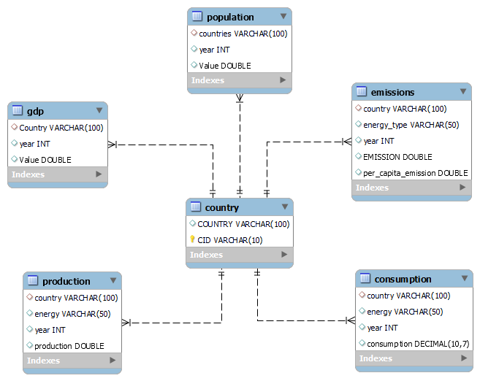
ER Diagram and Schema Explanation
Parent Table | Child Table | Cardinality
Country | Emissions | 1 : Many (1:N)
Country | Production | 1 : Many (1:N)
Country | Consumption | 1 : Many (1:N)
Country | Population | 1 : Many (1:N)
Country | GDP | 1 : Many (1:N)
Notes:
Why is country-to-emissions a one-to-many relationship?
Because a single country can have multiple emission records across different years and energy types, while each emission record belongs to only one country. Therefore, one country is related to many emission rows, making the relationship one-to-many.
The same explanation applies to:
Country -> GDP
Country -> Population
Country -> Production
Country -> Consumption
All of them store historical data (multiple years), so one country maps to many rows.

Slide 8
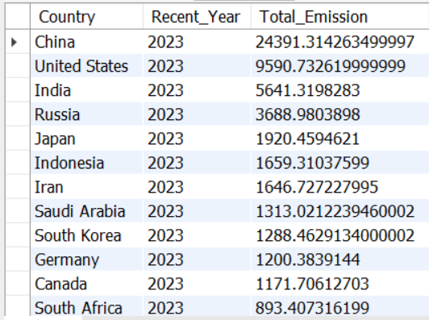
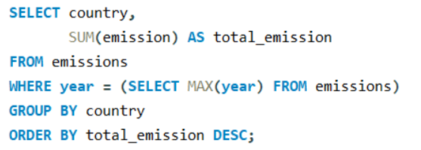
SQL Queries Results
01. Total emission per country for the most recent year available?

Slide 9
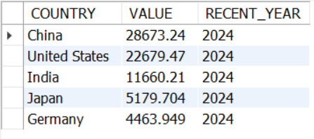
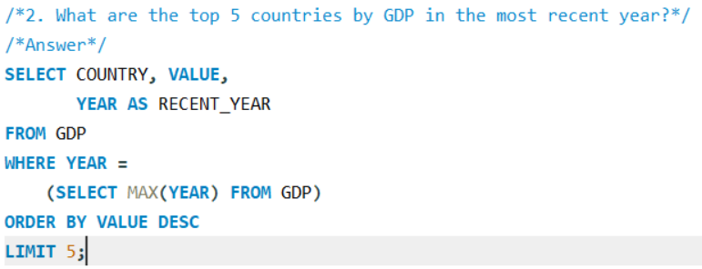
02. Top 5 countries by GDP in the most recent year

Slide 10
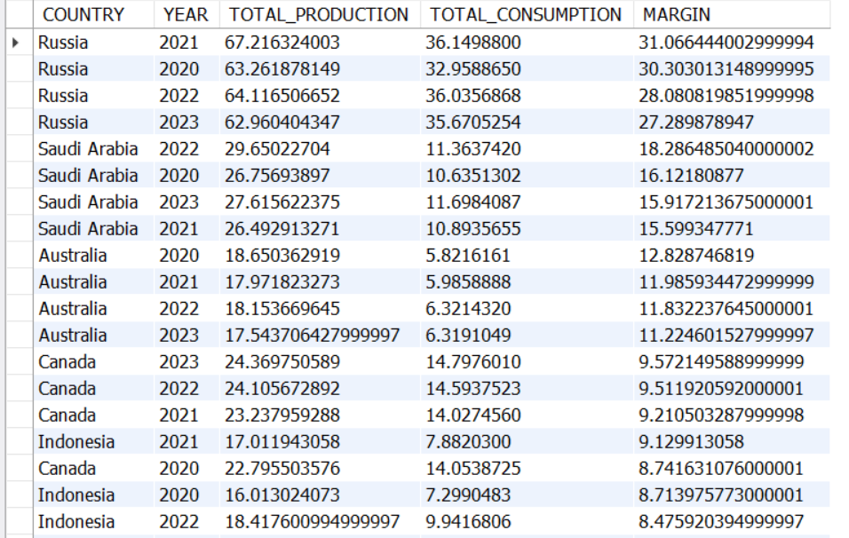
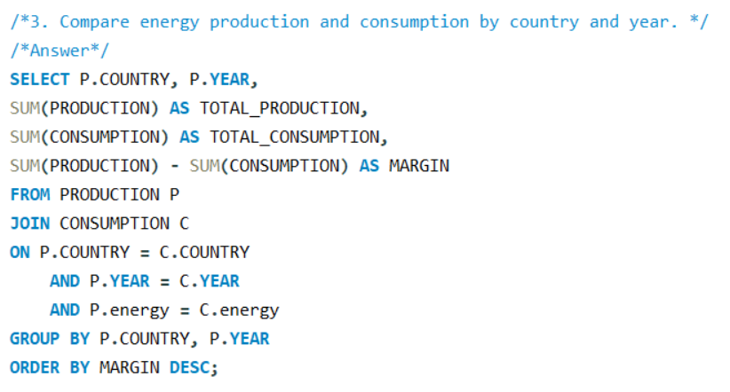
03. Compare energy production and consumption by country and year.

Slide 11
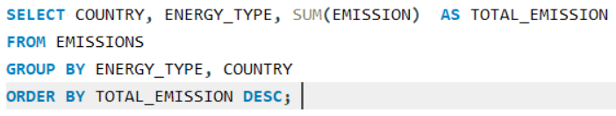
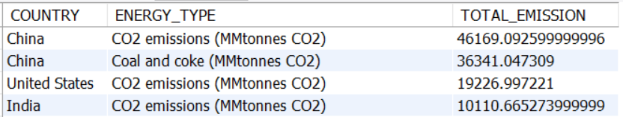
04. Which energy types contribute most to emissions across all countries?

Slide 12
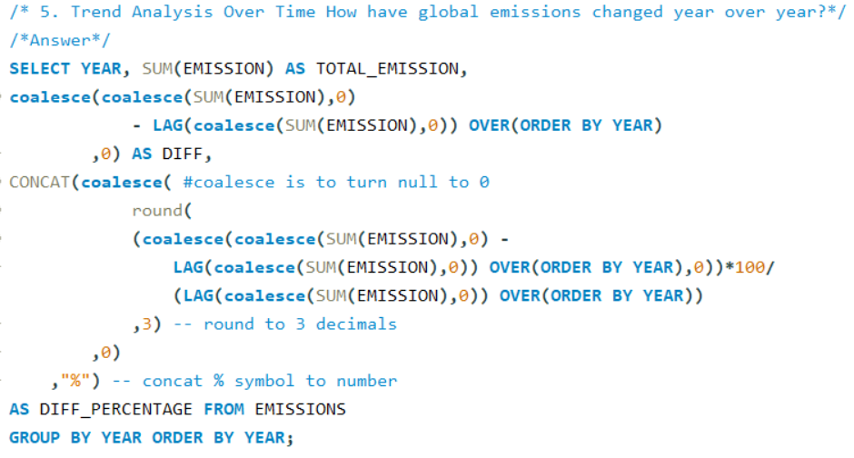
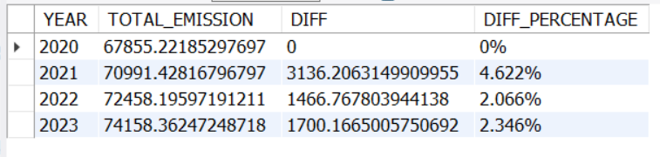
05. Trend Analysis Over Time How have global emissions changed year over year?

Slide 13
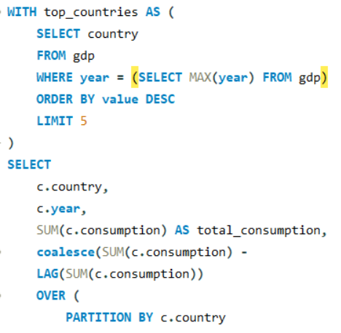
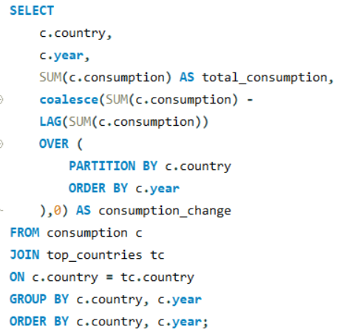
06. How has population growth affected total emissions of top 5 countries?

Slide 14
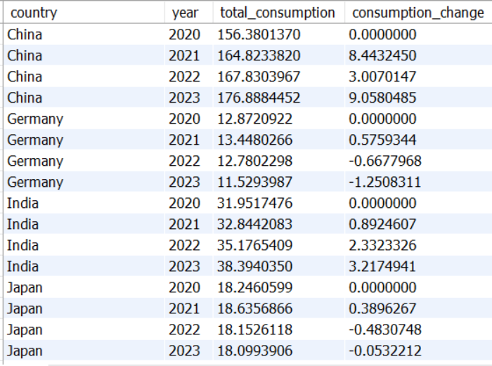
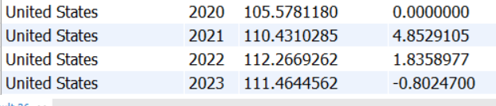
06. How has population growth affected total emissions of top 5 countries?

Slide 15
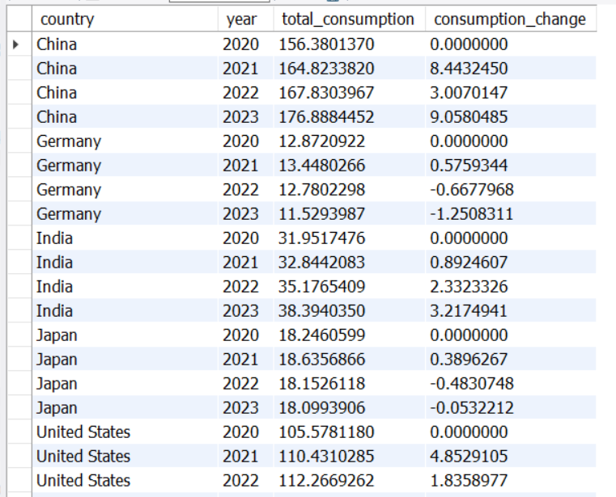
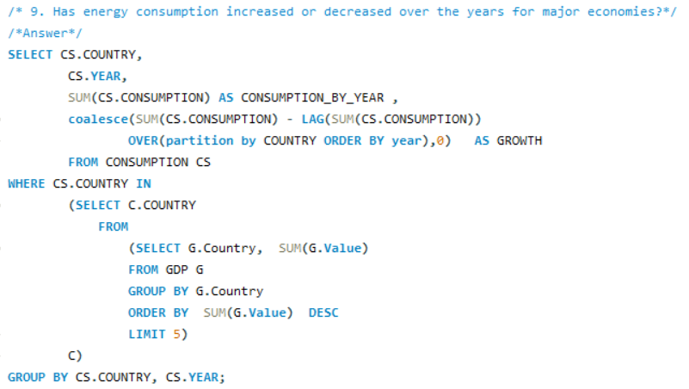
07. Has energy consumption increased or decreased over the years for major economies?

Slide 16
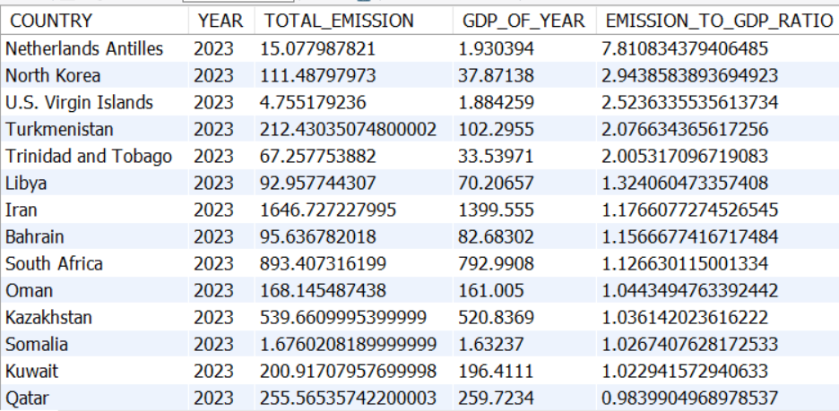
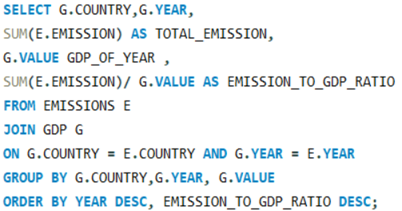
08. What is the emission-to-GDP ratio for each country by year?

Slide 17
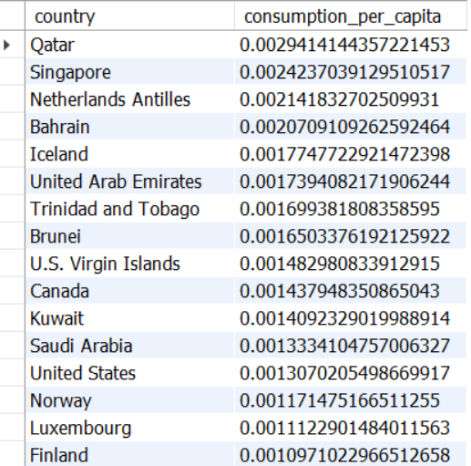
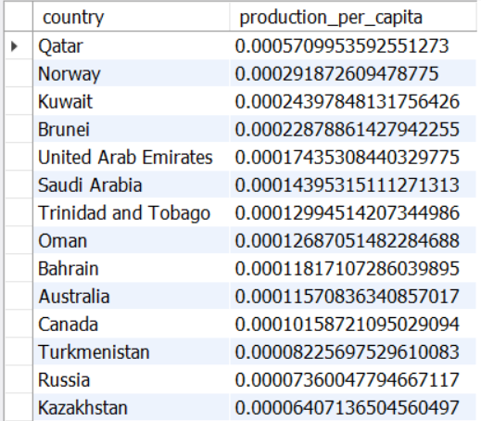
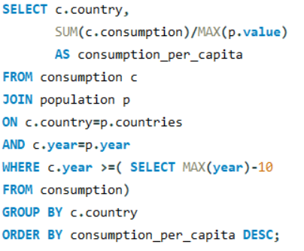
09. What is the energy consumption per capita for each country over the last decade?

Slide 18
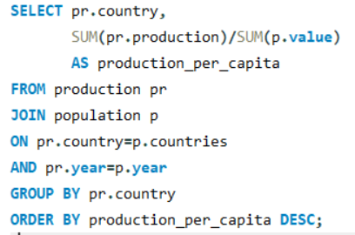
10. How does energy production per capita vary across countries?

Slide 19
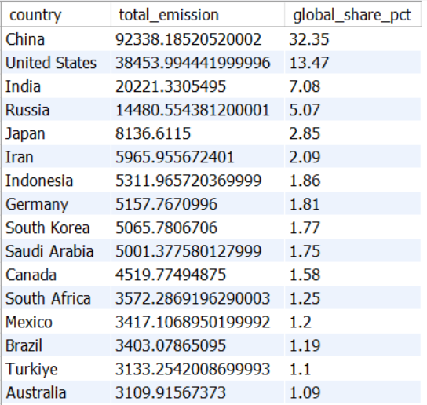
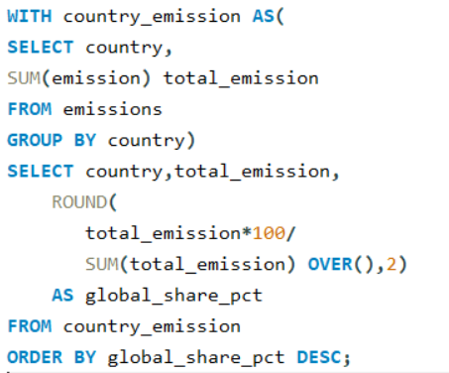
11. What is the global share (%) of emissions by country?

Slide 20
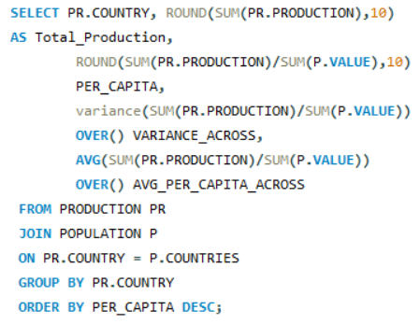
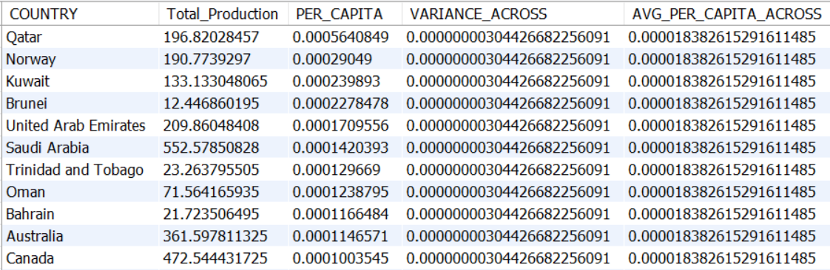
12. How does energy production per capita vary across countries?

Slide 21
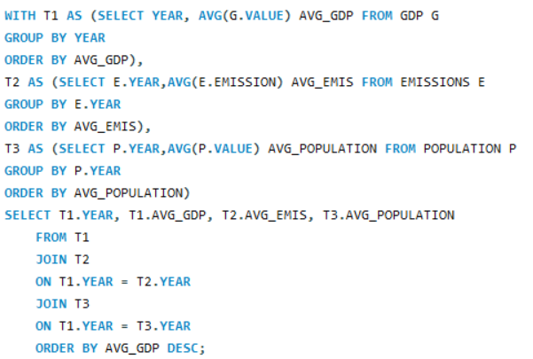
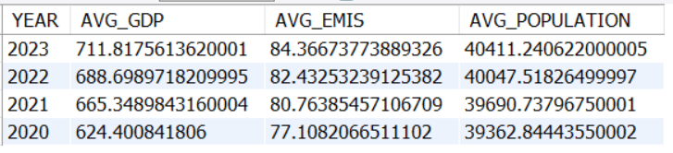
13. What is the global average GDP, emission, and population by year?

Slide 22
Business Key Insights
Economic Growth Drives Energy Demand: Countries with higher GDP generally exhibit higher energy consumption. Rapidly developing economies tend to increase energy demand faster than mature economies.
Fossil Fuels Remain Major Emission Contributors: Coal, oil, and natural gas contribute the largest share of emissions in most countries. Countries heavily dependent on fossil fuels typically have higher emission-to-GDP ratios.
Emission Efficiency Differs Across Countries: Countries with similar GDP levels can have vastly different emission levels. Lower emission-to-GDP ratios indicate better energy efficiency and cleaner energy adoption.
Population Growth Influences Emissions: Countries with large populations contribute significantly to total energy consumption. Population growth often increases energy demand, leading to higher emissions unless renewable energy adoption improves.

Slide 23
Conclusion
The analysis demonstrates that energy consumption, economic growth, and carbon emissions are closely interconnected. Countries experiencing strong economic and population growth generally exhibit increasing energy demand and higher emissions.
By examining emission trends, per-capita metrics, GDP relationships, and production-consumption patterns, this project provides valuable insights into global energy dynamics.
The findings can help policymakers, energy planners, and environmental organizations make informed decisions regarding sustainable energy development, carbon reduction strategies, and long-term energy security.

Slide 24
Recommendations
Promote Renewable Energy: Encourage the use of solar, wind, and other clean energy sources to reduce carbon emissions.
Improve Energy Efficiency: Use energy-efficient technologies and practices to reduce energy consumption without affecting economic growth.
Use Data for Better Planning: Regularly analyze energy, GDP, population, and emission trends to make informed energy and environmental decisions.

Slide 25


Slide 26

THANK YOU

